Slide 1
SLAM for an Autonomous Package Delivery Robot
Miguel Rodriguez
Project Work

Slide 2
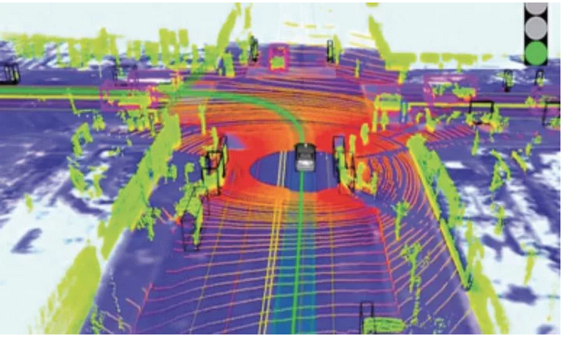
Goals
To build a prototype of an autonomous delivery robot
Generate a Simultaneous Mapping and Location (SLAM) for the robot

Slide 3
Related work
Visual SLAM
Camera based SLAM
NAV2
SLAM process based on LiDAR information and odometry
HECTOR SLAM
No odometry required
Map generated comparing data acquired from continuous measurements
First measurement is fundamental for correct calculations

Slide 4
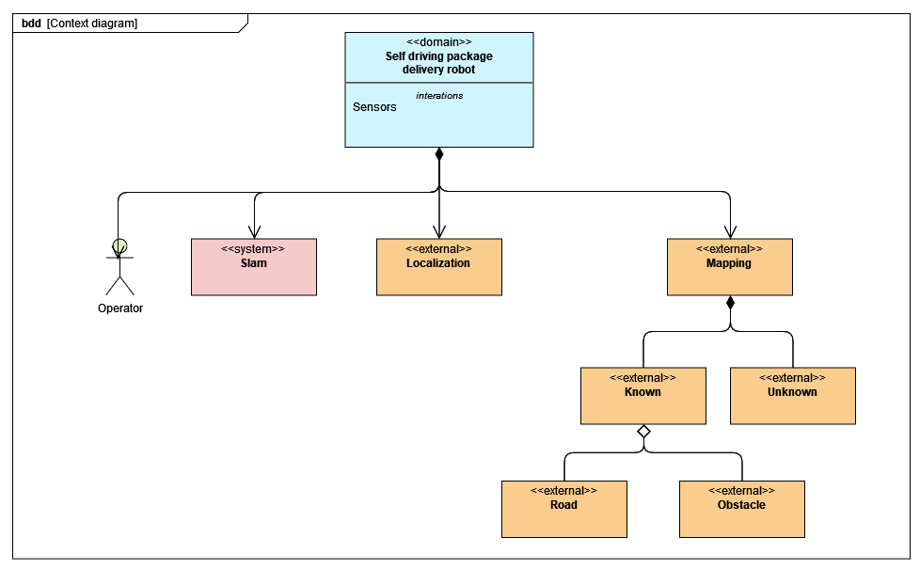
Structure Diagram

Slide 5
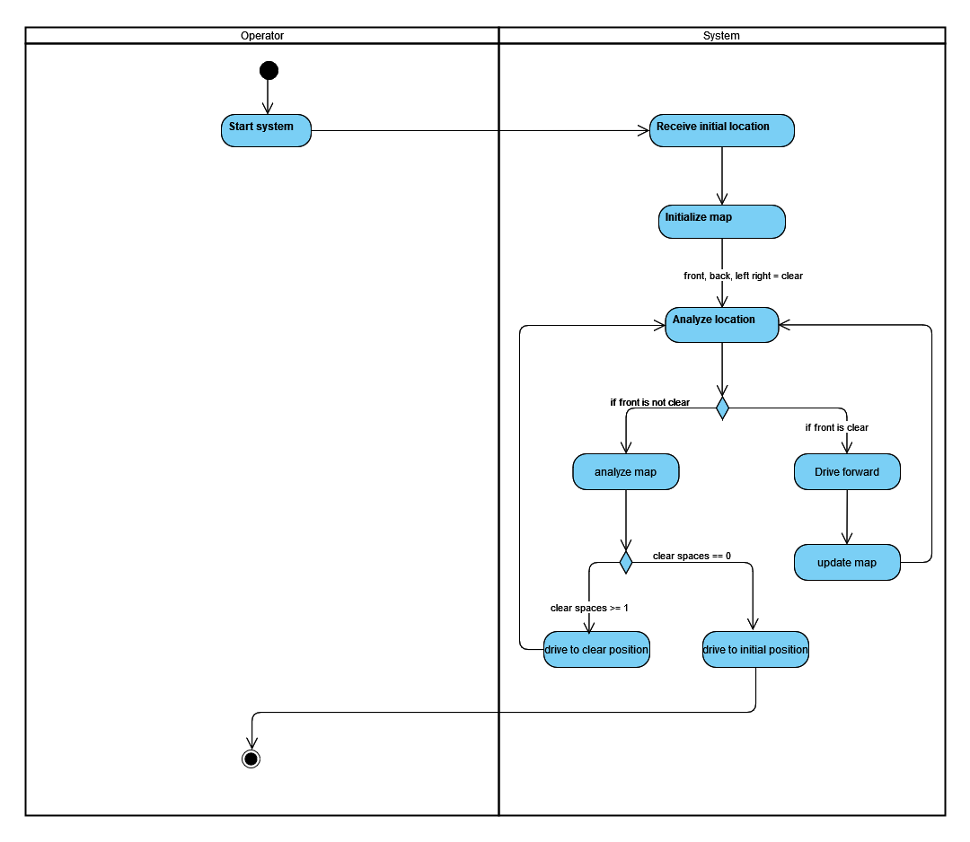
Activity Diagram

Slide 6
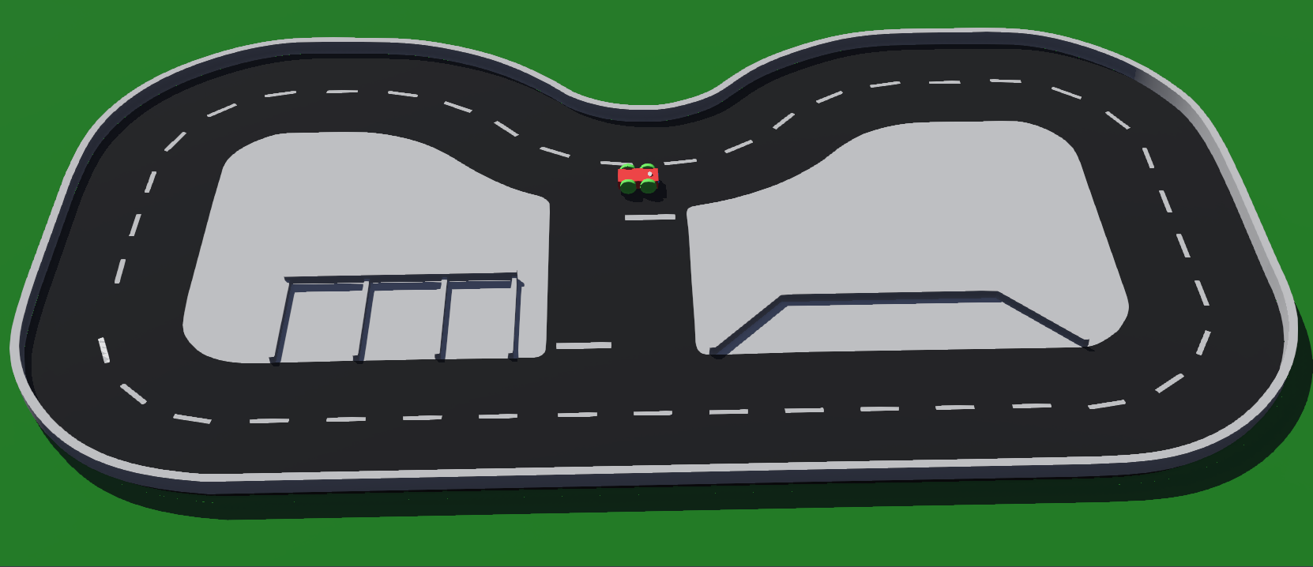
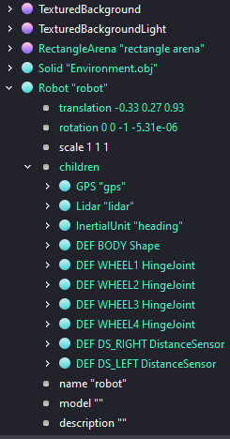
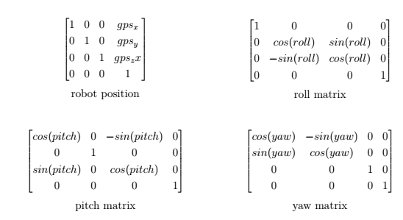
Design and implementation
Simulation in Webots

Slide 7
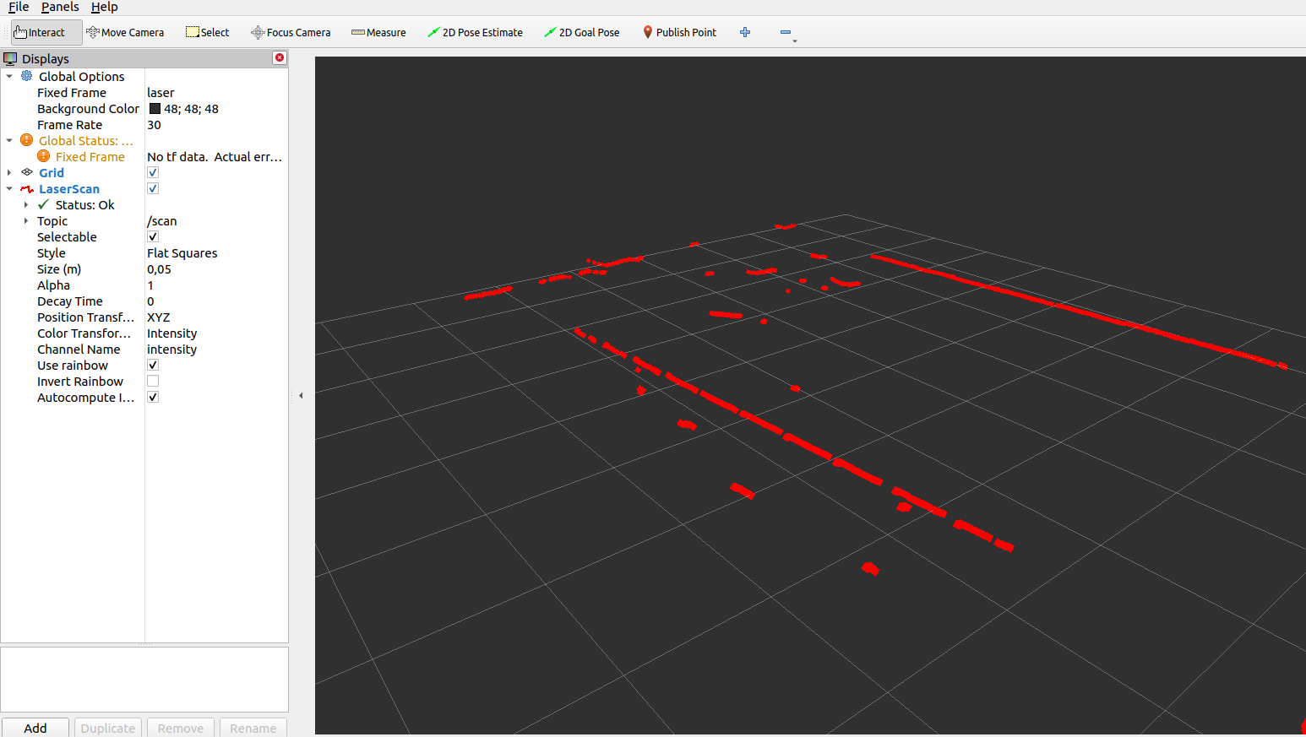
Physical project in ROS

Slide 8
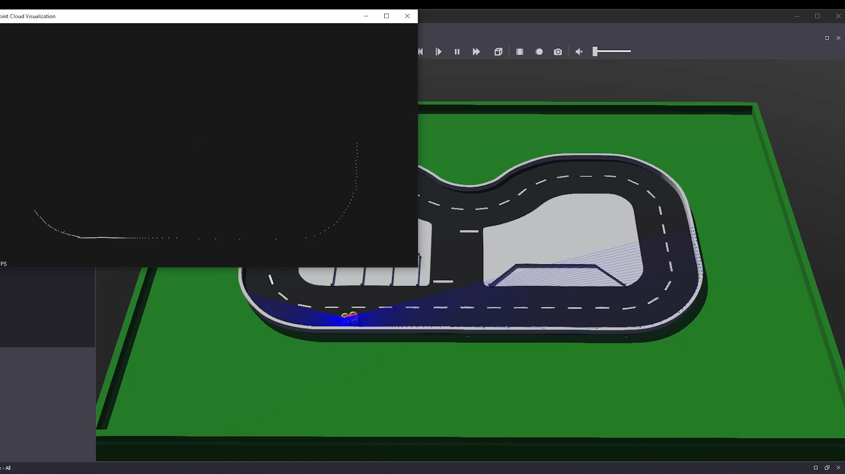
Webots point cloud map generation

Slide 9
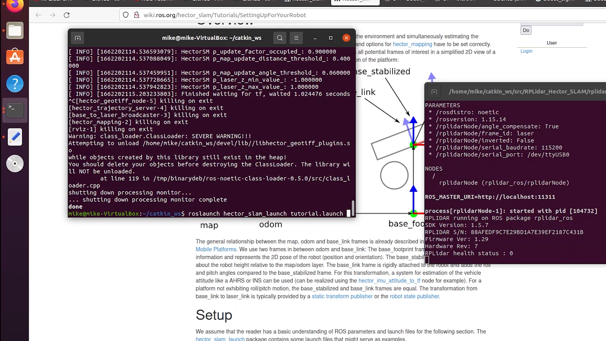
HECTOR SLAM

Slide 10
Outlook
Intagrate the 5 scenarios
Implement NAV2 using odometry
Implement a visual slam algorithm.

